Slide 1
SDEV2501
Day 03 - Summary Statistics

Slide 2
Today’s objective
Define, discuss, and calculate measures of central tendency
Notes:
i.e. describing the centre

Slide 3
Review

Slide 4
Review
What are the phases of the data science lifecycle?
What are the different data types?
When would we use a population? A sample?
What is a statistic? How does it differ from a parameter?

Slide 5
Interval vs ratio example
Calendar year
  Is the difference between 1999-2000 the same as 2019-2020?
  Can we subtract 1993 from today?
  Is the year 2000 “twice as big” as the year 1000?
  Does the year 0 mean “no time”?
Time of day
  Meaningful and equal difference between 2pm and 3pm?
Notes:
Calendar = ratio
Time of day
"The movie started at 7:00 PM" → interval
"The movie lasted 2 hours" → ratio

Slide 6
Summary statistics

Slide 7
Why do we need summary stats?
Condense a large dataset
Easily compare groups
Communicate data to other humans
Establish a baseline
Support decision-making

Slide 8
What single value could describe these #s?
2
10
5
6
4
5
Notes:
5 (count)
5 (most common)
10 (largest)
And so on….

Slide 9
Some terms to know…
Mean
Median
Mode
Notes:
Show real-world examples and examples of how to calculate
e.g. Excel notebook, calculator

Slide 10
Mean
This is usually what is meant when we say “average”
Calculated by taking the sum of all items, and dividing by the number of items
e.g. if my course marks were 82%, 54%, and 68%, my average would be ( 0.82 + 0.54 + 0.68 ) / 3 = 0.68 = 68%
Isn’t always meaningful… what is the average roll when we roll a die?
Easily impacted by extreme values.
When might we need to know the mean?
Notes:
Differentiate weighted mean

Slide 11
Median vs mode
Most simply: median is the middle number.
Helps us understand what the middle of the distribution looks like.
The mode is the most common number.
Sometimes the distribution has multiple modes (e.g. bimodal).

Slide 12
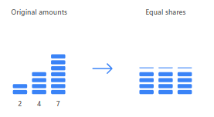
What question does each statistic answer?
Mean
If we distributed all the values equally, what would we each get?
Median
What’s the middle?
What number describes a typical observation?
Mode
Which value occurs most frequently?
Works for categorical data.

Slide 13
When can summary stats mislead?
What is the average salary of these 5 people?
  $40k
  $45k
  $50k
  $55k
  $1,000,000
What’s the average number when I roll a regular 6-sided die?
Takeaway:
Means are sensitive to extreme values, and summary statistics don’t necessarily represent a real-life observation.

Slide 14
When can summary stats mislead?
Let’s compare the hourly wages of 10 employees:
  $15, $16, $17, $17, $18, $120, $125, $130, $135, $140
  What are the mean and median? What does this tell us?
Here is the duration of 15 randomly selected Uber trips:
  8, 12, 12, 15, 16, 17, 18, 20, 21, 22, 23, 24, 25, 25, 47
  What is the mean, median, and mode? What does this tell us?

Slide 15
Calculate & Visualize Summary Stats
Using a dataset, calculate summary metrics
What types of questions can be answered?
What types of questions cannot be answered?
  Smallest & largest numbers
  How much the numbers vary
  Whether there are outliers
  How the values are distributed e.g. clustered, spread out…

Slide 16
Practice
Which measure should I use for?
  Deciding which sizes to stock in my store?
  Summarizing academic performance?
  Checking the star rating of my restaurant?
  Reporting the typical house price in my city?
  The typical # of hours people exercise in a week?
Notes:
Remember: depends on the question, the type of data, and the distribution

Slide 17
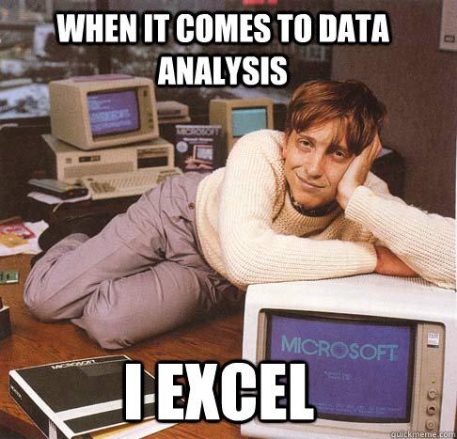
Closing
Reflect: Why might the median be more meaningful than the mean when analyzing financial income data?

Slide 18
What’s next?
Describing the shape and spread of data

